Slide 1
Reporting on Student Learning is Changing Moving Learning Forward Together: Information for Families
Fall 2022
Notes:
All content and supporting information for this slide deck have been accessed from the Ministry of Education and Child Care K-12 Reporting Policy Framework: Interim Supporting Materials and by the Reporting on Student Learning in BC is Changing – Brochure for Families
BC's curriculum supports the ways that students think, learn, and grow and prepares them for a successful lifetime of learning where change is continuous. The goal of the curriculum is to support the development of the educated citizens who are critical creative thinkers and communicators, and who are personally and socially responsible in all areas of their lives.
Curriculum, assessment, and the communication of student learning are interconnected. Today, we will briefly share how assessment and reporting on student learning is changing in our schools.

Slide 2
Acknowledgement

Slide 3
What is student reporting?
It provides families with a clear understanding of learning progress, learning needs, and what supports may be helpful. Some may also include goals for future learning.
It has various forms: conferencing, written reports, eportfolio posts, check-ins, etc.
It encourages students to engage in meaningful conversations that help them develop responsibility for deepening their learning.
Notes:
Student reporting is the assessment and communication of student learning. Assessment is an ongoing process and can involve a wide variety of tools that educators use to describe and evaluate students' progress towards meeting provincial learning standards.

Slide 4
Reporting on Student Learning is Changing in BC
Notes:
The Ministry of Education and Childcare has recognized the importance of meaningful communication, a focus on proficiency and the engagement of student self-assessment of learning and growth.

Slide 5
Use of the Provincial Proficiency Scale
Notes:
Assessment that is focused on student proficiency in relation to learning standards of the provincial curriculum will be of focus across the province. Use of the provincial proficiency scale to provide a clear understanding of where students are now and areas for future growth will be how teachers share with families and caregivers about student progress in all areas of learning via Learning Updates and a Summary of Learning. It is a requirement for student reporting in grades K-7 now, and will be continued practice in grades 8-9 in the year 2023-2024.
Watch this short video to unpack the four-point provincial proficiency scale.

Slide 6
Student self-assessment of the Core Competencies and goal-setting.
Notes:
One key finding of current research that the Ministry considered in the shaping of the reporting policy is that self-assessment leads to an increase in student confidence and their abilities, greater responsibility for their own learning, and greater student satisfaction. Thus, students will be engaged in regular and on-going self-assessment of the Core Competencies and they will be invited to do some goal-setting for these competencies that support students in their growth as educated citizens.
Students are encouraged to connect the Core Competencies (Communication, Thinking, and Personal and Social) with their learning in school and beyond.

Slide 7
Use of Descriptive Feedback
Notes:
Emphasis on providing students descriptive feedback that highlights strengths, stretches, and next steps for moving learning forward will be shared in written comments on Leaning Updates and in conversations with families.
Teachers may also highlight student behaviour and engagement in descriptive feedback, informally or formally, if the need arises and on a student-to-student basis.

Slide 8
How is the Richmond School District implementing the Ministry Reporting Guidelines? “Communicating student learning effectively is central to student success.”
Notes:
The Richmond School District aims to inspire everyone in our educational community to be lifelong learners. Part of learning is receiving timely and effective communication from teachers. Student learning is best supported when families are made aware of any student learning needs and what supports may be helpful. All elementary schools in the Richmond school district will offer a consistent form of reporting and will have similar timelines for reporting across schools.

Slide 9
When does reporting happen throughout the year?
Notes:
As per Ministry Reporting Guidelines, there will be 5 opportunities for communication with families about student learning in a year, which include:
2 Conferences: teachers offer feedback about ​growth in literacy, numeracy and SEL.
2 Written Learning Updates (often thought of as a report card): teachers offer feedback and proficiency scale descriptor for all areas of learning
1 Summary of Learning: teachers offer feedback and a final proficiency scale descriptor for all areas of learning
Goals for future growth will be identified by teachers for Mathematics, ELA, and Français Langue at each written update, and for all other areas of learning at least once in a school year.
Students will be invited to reflect and engage in Core Competencies self-assessment throughout the year. Documentation of this will be on the student eportfolio.
*The timeline for these communications may vary slightly if your child attends a year-long calendar model school.

Slide 10
What's the same?
What's new?
Timely and responsive feedback to families throughout the school year
5 communications of student learning
3 written updates
2 conferences
Written descriptive feedback
Letter grades and percentages for grades 10-12
Student reporting practices that align with BC's curriculum and provincial assessment system
Provincial proficiency scale at grades K-9
Student self-assessment of Core Competency and goal setting at all grades
All learners, including students with a disability or diverse ability, will receive regular communications of student learning in the same way as their peers in any other program
Notes:
Letter grades and percentages for grades 10-12:
Most universities and colleges currently use letter grades and percentages as part of the admissions process. To continue the successful transition of B.C. students to post-secondary learning, letter grades and percentages will remain in the graduation years. However, the Ministry of Education and Child Care will work with post-secondary institutions in the coming years to explore the use of the Provincial Proficiency Scale at Grades 10-12.

Slide 11
Eportfolios continue to be valuable tools for student learning
Portfolios continue to be used for Core Competencies
AND
Digital portfolios can continue to be used:
To document student learning
As a vehicle for formative assessment
As a window into learning
Notes:
You may see a change in the way teachers are using eportfolios to enhance and communicate student learning. They will be used to house documentation of Core Competencies self-assessment, and can be used to provide a window into learning...

Slide 12
Families
" The partnership of student, family, and school creates a bridge of support that helps our children be successful in their learning.”
Teachers
SBT
Learners
IST
Peers
Communities
Learning Partners
Notes:
We collectively, as a community, contribute to the education of our children, so teachers, students, and families are partners in the growth and development of the child’s learning experience. Communication with teachers and support staff is crucial for student success.

Slide 13
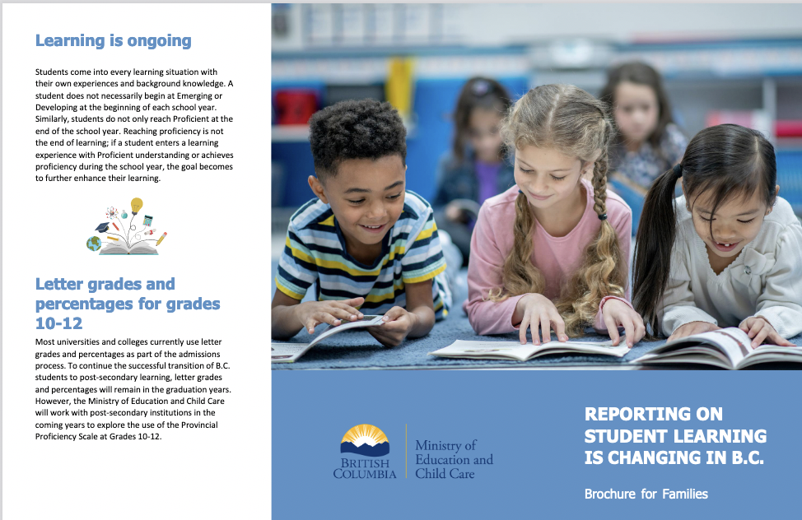
More Questions?
Ministry Document
Talk to your child's teacher
Reporting on Student Learning is Chaning in BC - Brochure for Families
If you have further questions about what the communication of student learning will look like this year, reach out to your child's teacher(s).
student.reporting@gov.bc.ca

